Slide 1




Data Science Project 2021
Presented By:
Yarden Ankonina & Alon Sapozhnikov

Slide 2
Introduction
Our project will revolve around the basketball world – in particular the NBA.
We wanted to take a world of data that we are interested in, and we went through a process to find the right research question that intrigued us while we could learn something new from it with the tools we acquired in this course.

Slide 3
Introduction
The NBA has a lot of interesting statistics but there is a statistic that combines them all, under the name PER.
We will use it to estimate the success of the players in their season.
Further explanation of the PER figure in the next slide.

Slide 4
Introduction
What is PER?
The player efficiency rating (PER) is John Hollinger’s
rating of a player’s per-minute productivity.
The PER attempts to boil down all of a player's contributions into one number, using a detailed formula.
Link for the formula and more explanation on PER : LINK2
LINK1

Slide 5
The Process
The Main Steps of Our Project
Web Crawling
Visualization
Conclusions
1
2
4
2
3
4
5
3
5
6
Research Question
Data
Cleaning
Machine
Learning

Slide 6
Research Question

Slide 7
Research Question
Can we predict a player’s PER using machine learning based on his stats?
Can we predict a player’s PER in his next year using machine learning based on his stats?
Can we predict the 2021-2022 MVP of the year based on PER?
We will try to answer these questions in our project

Slide 8
Web Crawling

Slide 9


Web Crawling
We used web crawling in order to acquire our data
We got our data from :
https://www.basketball-reference.com/leagues/NBA_2021_totals.html
https://www.basketball-reference.com/awards/mvp.html
https://en.wikipedia.org/wiki/Player_efficiency_rating
Using the libraries
Requests & Beautiful Soup

Slide 10
Web Crawling
Our Data :
We collected all the stats of each player in each season from 1990 to 2021 – that’s 30 years of basketball analytics.
We collected the MVP (most valuable player) data in each season from 1990 to 2021.
We collected the Hollinger theory category data showing the meaning of the PER value.

Slide 11
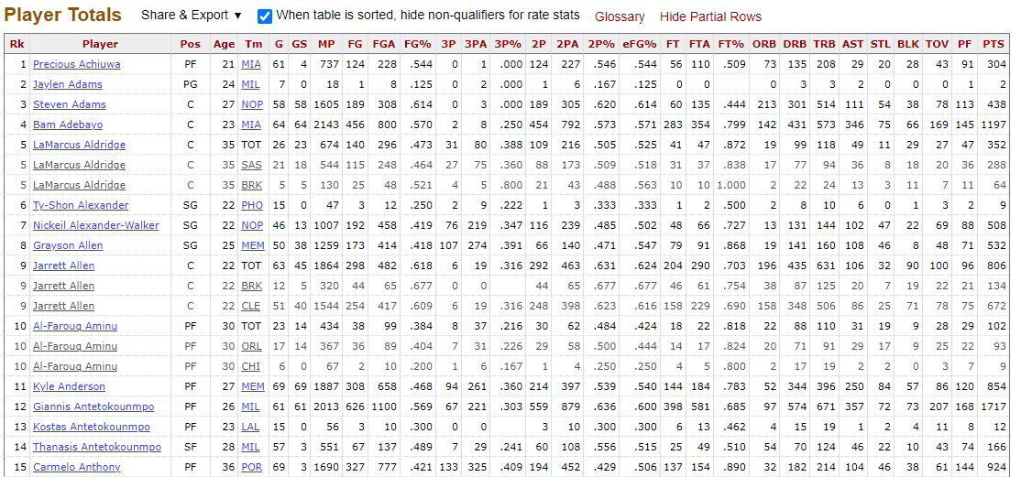
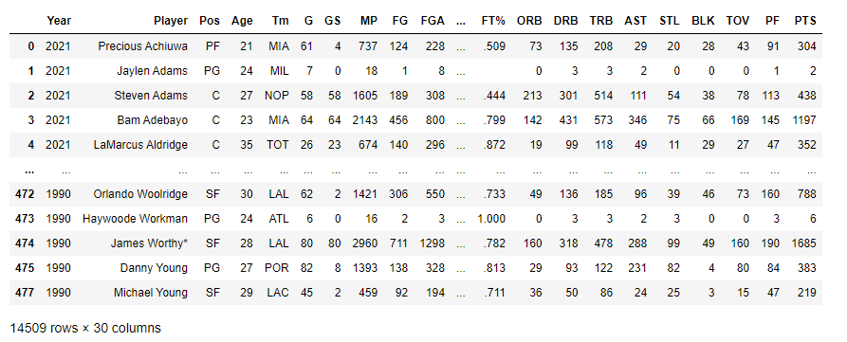
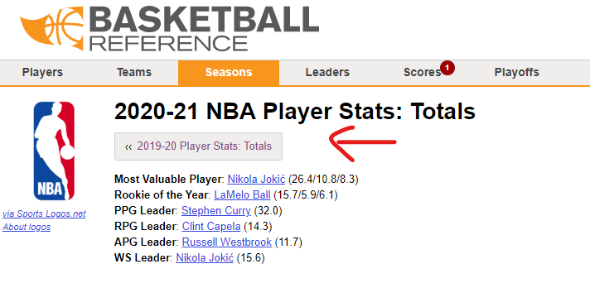
Web Crawling
The table from which we took the data
All players’ data frame
Going through pages for each year
We added a year value for each player

Slide 12
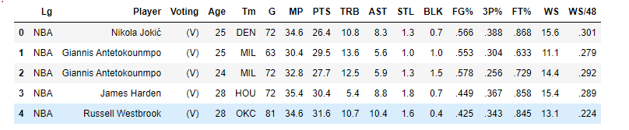
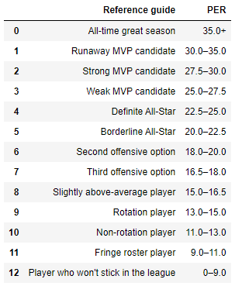
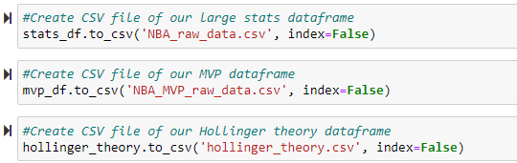
Web Crawling
MVPs data frame
Hollinger theory category data frame
Export data frames to CSV files

Slide 13
Web Crawling
Worth Mentioning:
The website was easy to scrap using beautiful soup.
Each year has roughly 500 players times 30 years - that’s 15,000 rows of players with almost 30 stats each.
Some players move teams in the middle of the year; therefore, they are duplicated. We decided to limit each player to one team per year - the team where they played the biggest number of games.
We created a Data Frame for each year in a loop, then removed duplicates, and finally merged all data frames into one.
Collecting the data for MVP players and Hollinger’s theory didn’t cause new difficulties.

Slide 14
Data Cleaning

Slide 15
Cleaning The Data
How did we handle the data?
Remove missing data.
Fill missing values.
Handle outliers that are not necessary for our needs (ex: remove players who played under 20 games or didn’t play any minutes).
Format columns from object to numeric.
Add a PER column based on Hollinger’s formula – calculate the PER for each player.

Slide 16
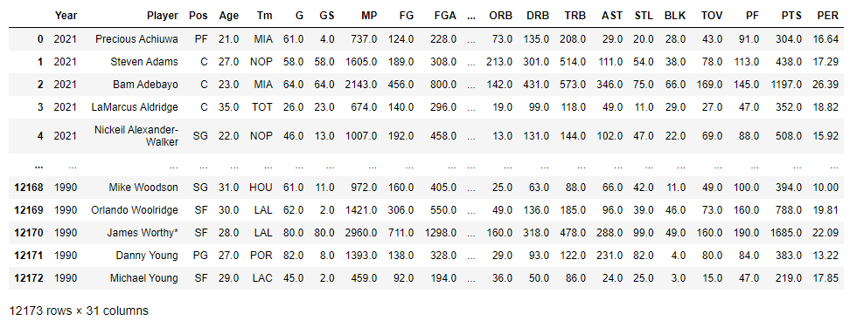
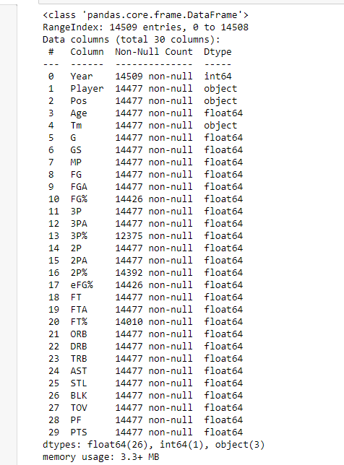
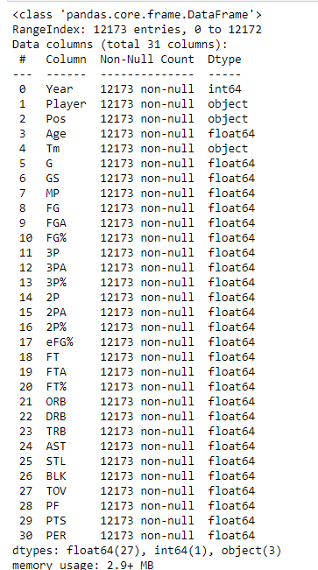
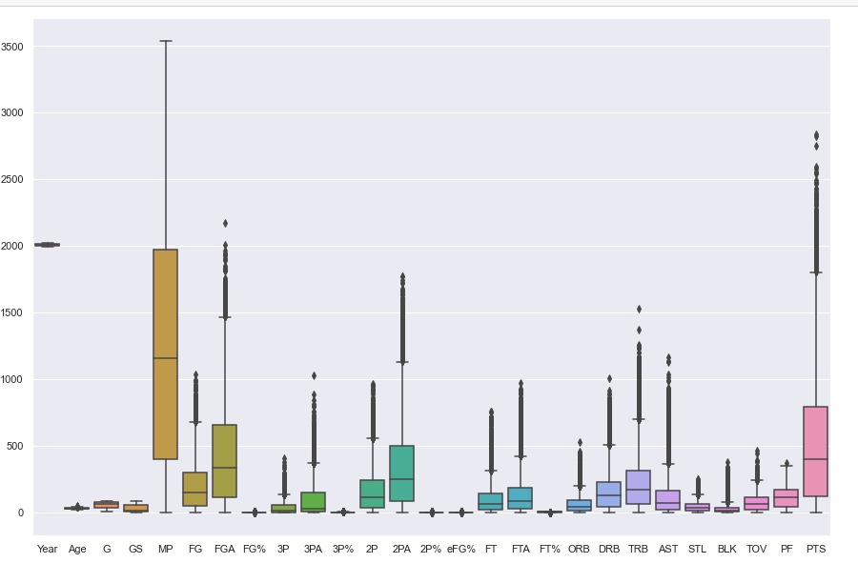
Cleaning The Data
Adding PER
Before
After
Outliers – boxplot(seaborn library)
We removed 2000 unnecessary rows

Slide 17
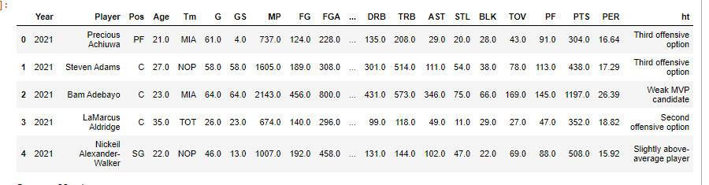
Cleaning The Data
Adding Hollinger’s theory

Slide 18
Visualization

Slide 19
Visualization
We visualize our data and then analyze it to try to learn more about it.
We will use seaborn, matplotlib visual libraries.
What do we visualize?
Hollinger theory category data frame
MVP vs highest PER
We examine our data frame and visualize the correlation with a heatmap
We will take the highest correlations (above 0.6) and show them as pairplot – to have a graphical way to see the correlations.

Slide 20
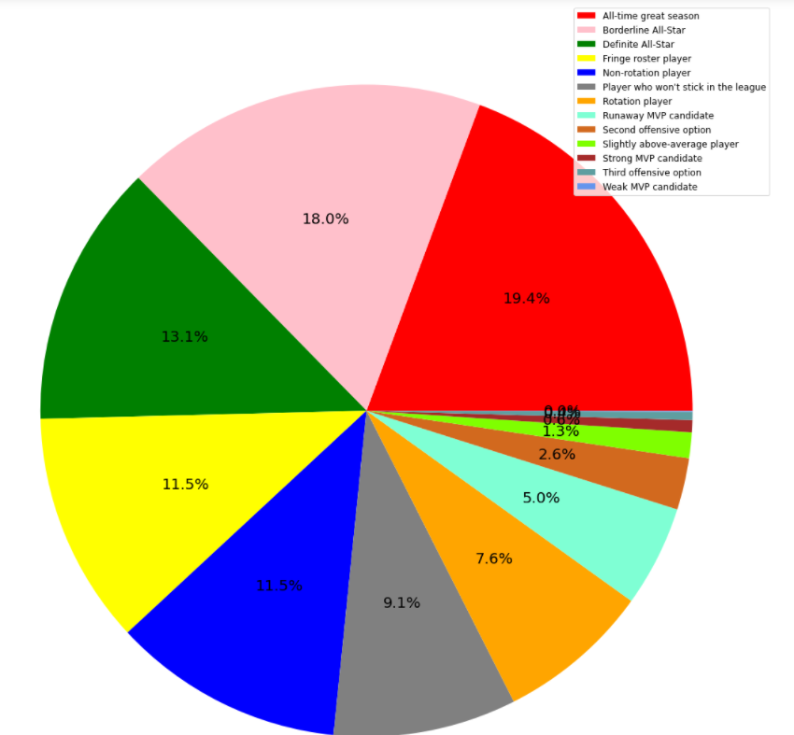
Visualization
Hollinger theory category data frame
We can see how many players belong to each value of Hollinger’s theory

Slide 21
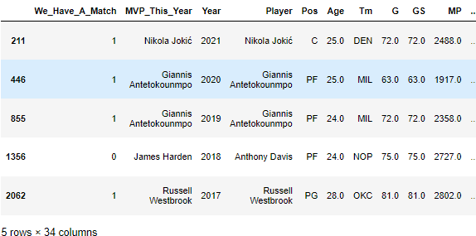
Visualization
MVP vs Highest PER
We created a new data frame that shows the current year’s MVP in one column and the player with the highest PER in another.
We made another binary column (“We_Have_A_Match”) that gets a value of 1 if the MVP is the player with the highest PER and 0 if he’s not.
We will show visualization and more analysis about this topic in the next slide.

Slide 22
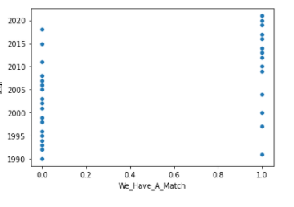
Visualization
MVP vs Highest PER
We examined the relationship between the player with the highest PER and the MVP of that season
We notice that as we go up in years the connection between the PER and the MVP is stronger.
Why is that?
The NBA changed the rules around the 1990s-2000s (calling more fouls – increased free throws, banning the use of elbows).
But the big change happened around 2004 when they started to implement those rules and added even more (source : ttps://en.wikipedia.org/wiki/Player_efficiency_rating).
We can infer from these rules the change in the MVP to high PER correlation.

Slide 23
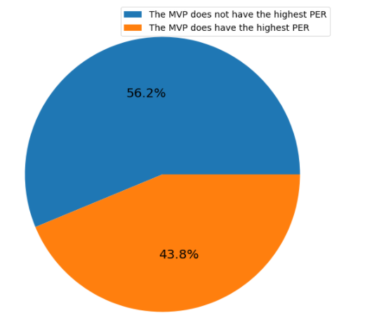
Visualization
MVP vs Highest PER
We examined what percentage of MVP players had the highest PER of their season in the last 30 years.
We can see that almost half of the MVPs had the highest PER in the league – that’s an amazing stat!
Note : (The NBA MVP is chosen by a voting panel of sportswriters and broadcasters throughout the United States and Canada)

Slide 24
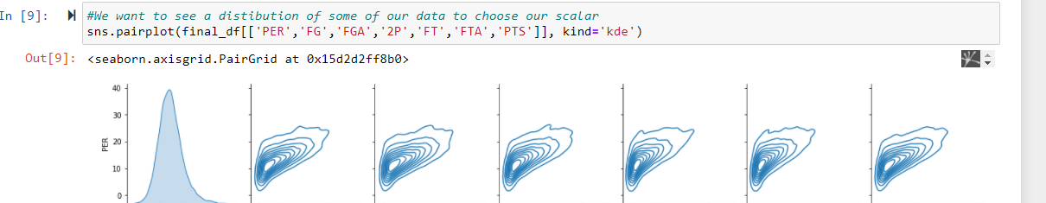
Visualization
Hashmap PER row
PER pairplot with high correlation columns
We can see that the correlation is close to linear but not completely

Slide 25
Machine Learning

Slide 26
Machine Learning
We need to solve two problems:
1.Predict a player’s PER based on his stats
2.Predict a player’s PER in his upcoming year based on his stats (Future PER)
How did we do it?
We used linear regression that belongs to the library sklearn.
We got rid of categorial columns /columns we don’t need for our model.
We split our data using train_test_split function without our PER column/Future PER column.
We trained our model and tried to predict the PER/Future PER.
We tried to improve it with other algorithms and methods.

Slide 27
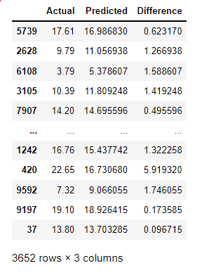
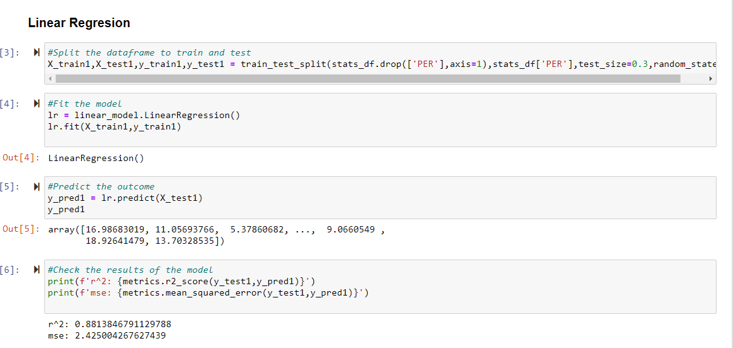
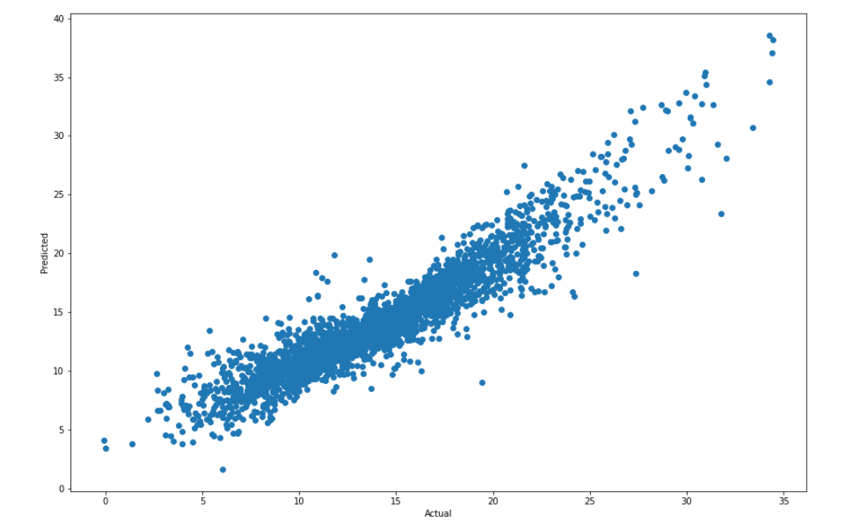
Machine Learning
Predict a player’s PER based on his stats
We can see what is the real PER and what is the predicted one
Linear Regression – r^2 is 0.88 which is quite accurate
Visualization to see actual vs predicted

Slide 28
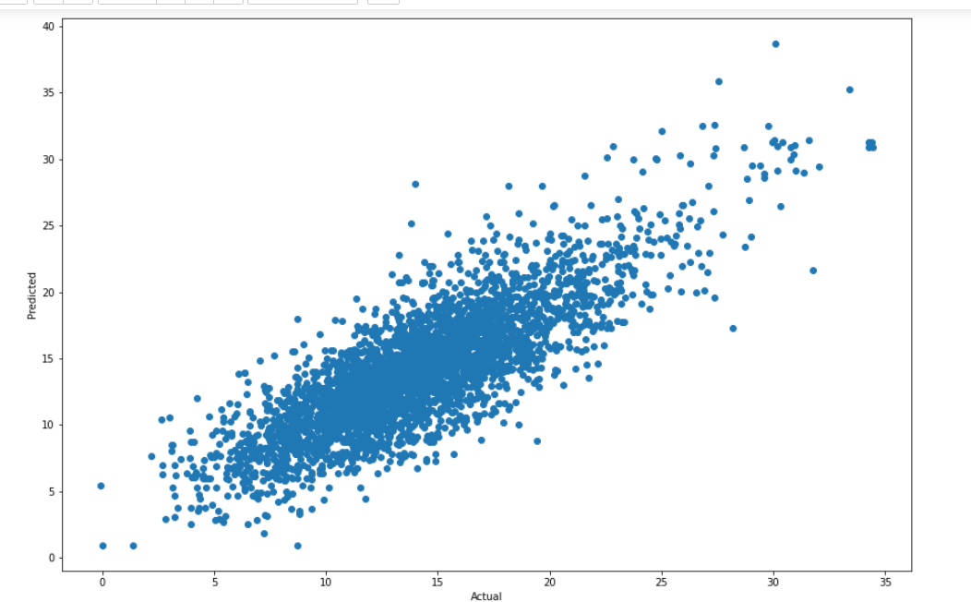
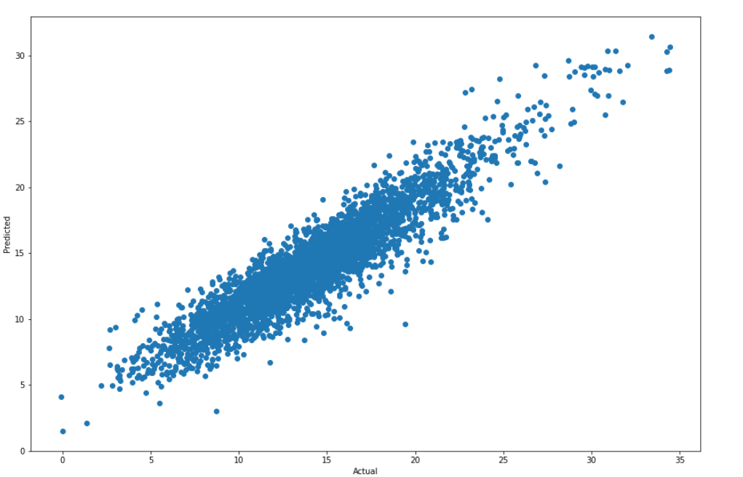
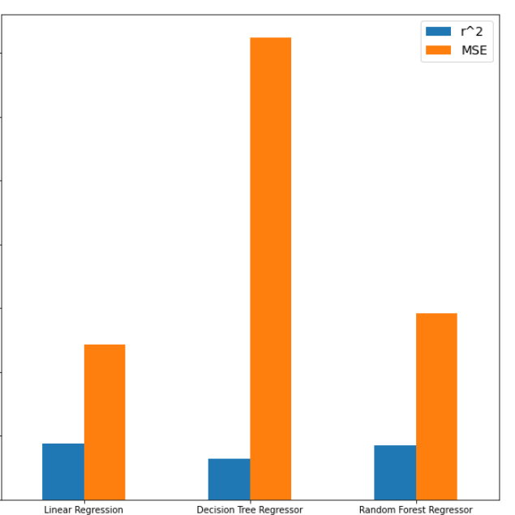
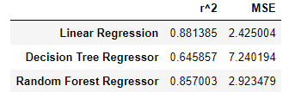
Machine Learning
Predict a player’s PER based on his stats
We tried more regressor algorithms :
Decision Tree Regressor
Random Forest Regressor
We can see that the linear regression is the best algorithm out of the three (although Random Forest Regressor is not too far off)

Slide 29
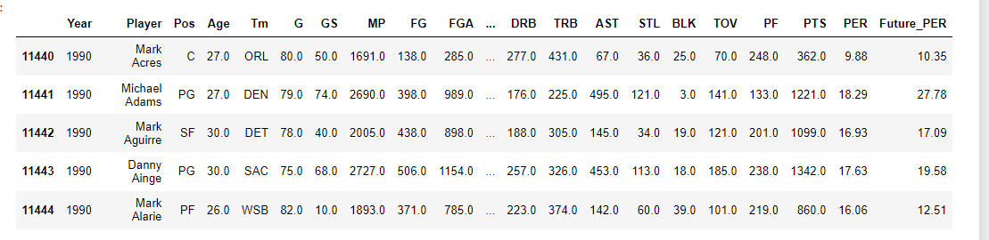
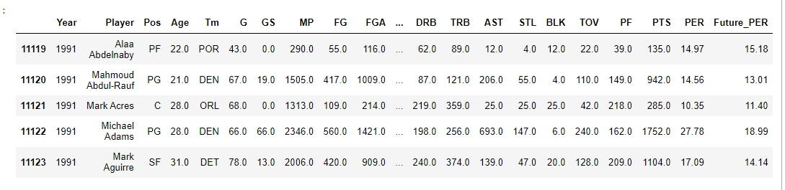
Machine Learning
Predict a player’s PER in his next year based on his stats
First, we had to create the column Future PER which contains the PER for the next year

Slide 30
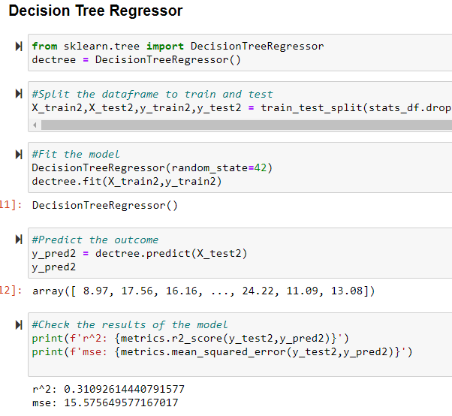
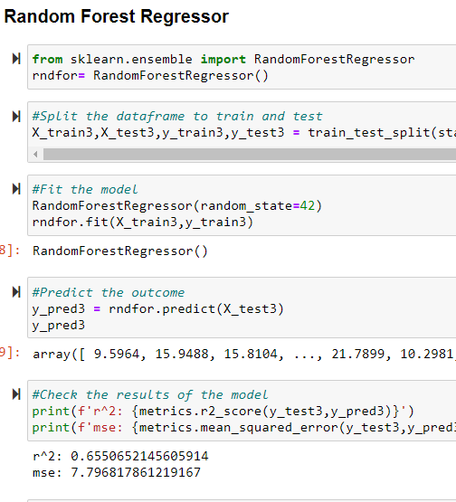
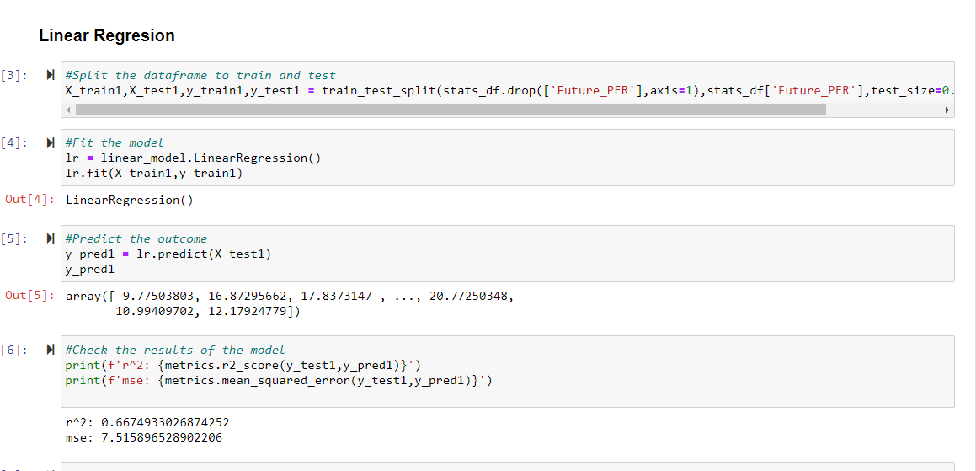
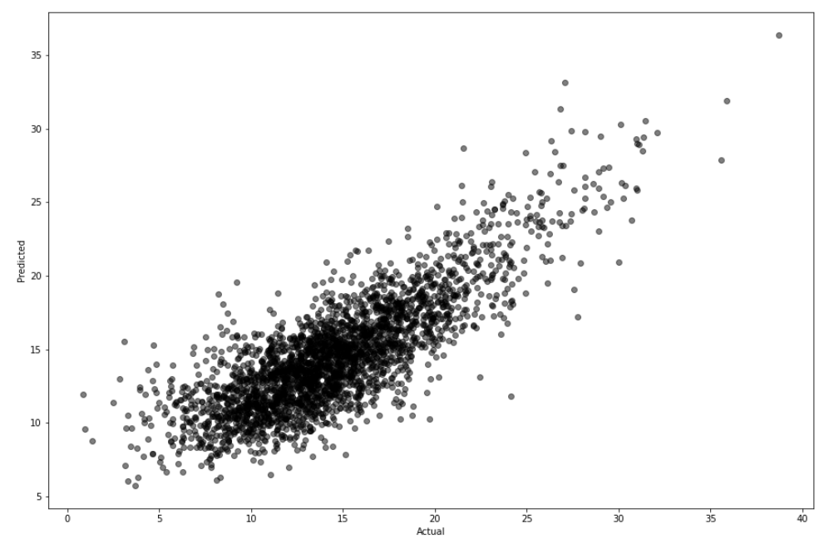
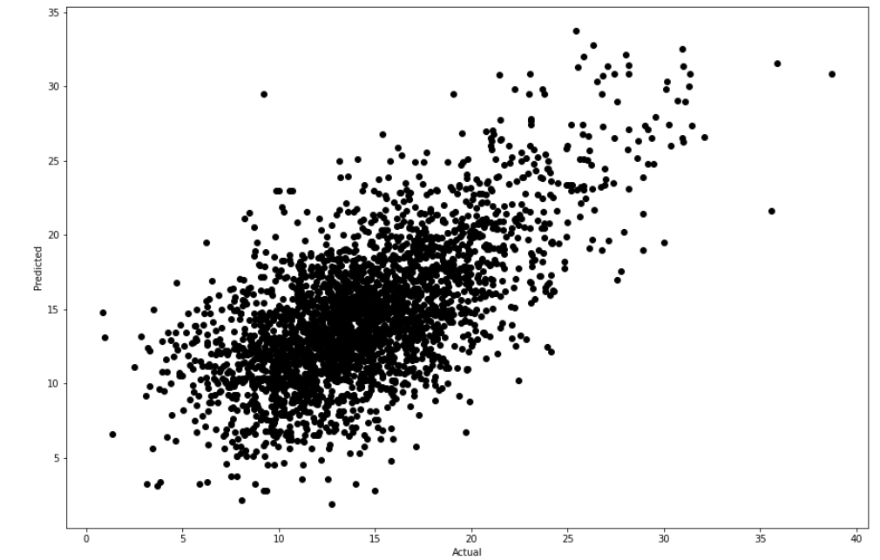
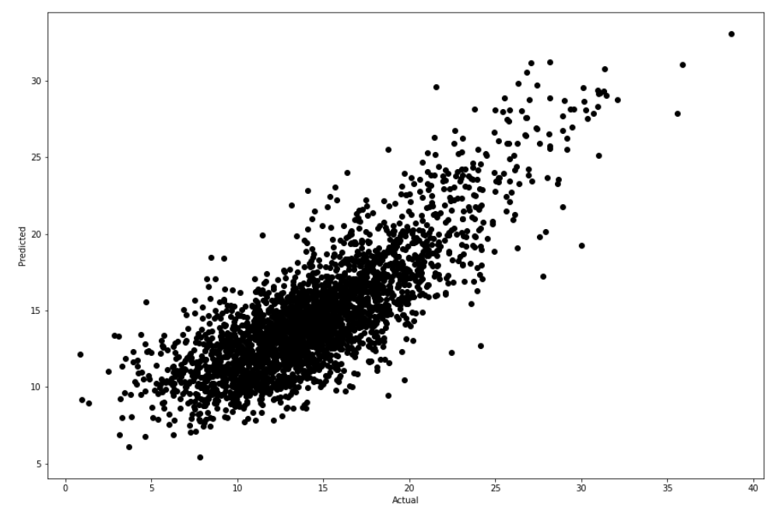
Machine Learning
Predict a player’s PER in his next year based on his stats
Second, we will create a model from 1990 to 2020 (because we don’t have the future PER of 2021) using the same way we worked the previous problem, and check all the algorithms and actual vs predicted graphs

Slide 31
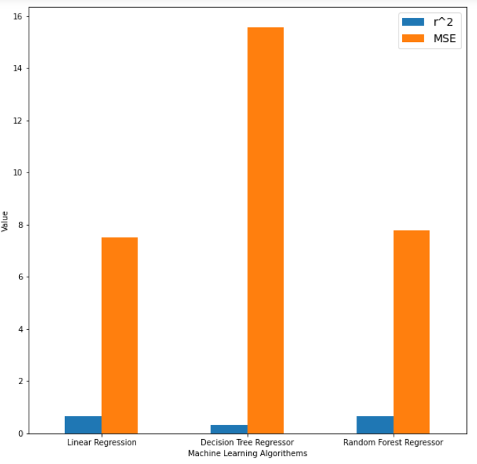
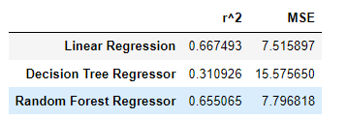
Machine Learning
Predict a player’s PER in his next year based on his stats
We can see that the best algorithm is the linear regression, but its r^2 score is 0.667 after all the improvements we could make. That’s not ideal but not bad either.

Slide 32
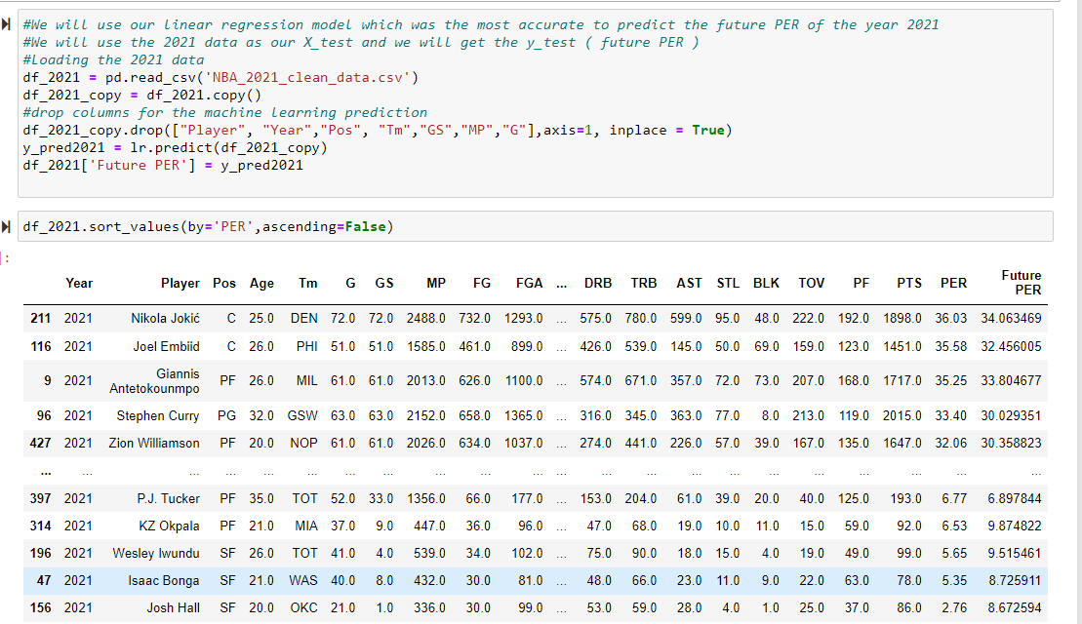
Machine Learning
Predicting the 2021-2022 MVP based on the highest PER value
We will use the model we trained for the Future PER and we will apply it on our current year:
We created a data frame of players who play in 2021
We will use the model we made to predict the 2022 PER
The player with the highest PER has a good chance of winning the MVP next year (assuming the model predicted correctly but there is always room for error)
And the predicted 2021-2022 NBA MVP IS…….

Slide 33


Machine Learning
Predicting the 2021-2022 MVP based on the highest PER value
Nikola Jokic’
Now we need to wait for next year to see if what we predicted is true

Slide 34
Conclusion

Slide 35
Conclusion
We were able to predict the PER accurately using the player stats
We were able to predict the Future PER using the player stats but with more room for error
The players with the highest PER have the best chances to win MVP
PER has changed since the 1990s and since the 2000s and we believe it will keep changing as long as the game of basketball continues to change
Our model predicts that Nikola Jokic’ will have the highest PER for the
2021-2022 season and therefore have the best chances of winning MVP

Slide 36
WOW
PER Calculator
Instructions:
Press on Link
Or
Open file and drag it to google chrome
(Works only on PC)

Slide 37
Thank You
Yarden Ankonina
GitHub(main)
Alon Sapozhnikov
GitHub(fork)

